Slide 1
DATA STRUCTURES

Slide 2
What is Data Structure ?
To properly understand Data Structures as implemented in the C programming first lets asks ourselves what is data ?
Data is : a collection of characters,numbers or symbols on which operations are performed by a computer.
In C data is categorized by data types eg : float , int , char , float double etc.
It is when this data has been processed that it becomes information and for us to use this information it has to be presented in a meaningful format for both you (the user) to understand and access and for the Computer to execute.

Slide 3
So a data structure is : A systematic way to organize data so that it can be assessed and processed into a meaningful format(information)
Examples of the mostly used data structures in the C language are:
  Arrays
  Linked Lists
  Trees
  Stack
  Que

Slide 4
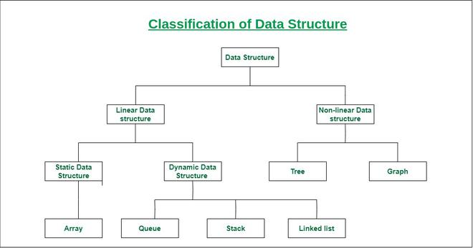
Classification of Data Structures

Slide 5
1. Linear Data Structures
Linear data structure: The data elements are arranged sequentially or linearly, where each element is attached to its previous and next adjacent elements
In Linear Data Structures we have 2 classifications:
    Static Data Structures
    Dynamic Data structures
Static data structure: Static data structure has a fixed memory size. It is easier to access the elements. Eg : Arrays
Dynamic data structure: In dynamic data structure, the size is not fixed. It can be randomly updated during the runtime. Eg : queue, stack, etc.

Slide 6
2. Non-linear data structure
Non-linear data structure: Data structures where data elements are not placed sequentially or linearly
In a non-linear data structure, we can’t traverse all the elements in a single run only.
Examples of non-linear data structures are trees and graphs.

Slide 7
Basic Operations in DSA
The data in the data structures are processed by certain operations. The particular data structure chosen largely depends on the frequency of the operation that needs to be performed on the data structure.
They key operations performed on data structures include :
      Traversing
      Searching
      Insertion
      Deletion
      Sorting
      Merging

Slide 8
Why its important to choose the right data structure ?
Efficiency should be your major determining factor when choosing a data structure.
In DSA efficiency is measured in terms of time and space.
The IDEAL data structure should be one that takes the least amount of time to perform operations and the least amount of space .
You can also take into account the complexity of the operations performed on the data structure. One operation may be easier on one d.s versus another d.s

Slide 9
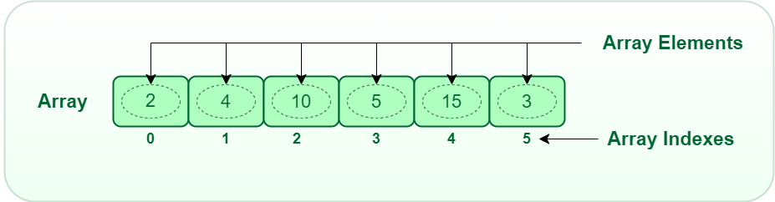
ARRAYS in C
An array is a collection of data stored at a memory location in which this data is of the same type.

Slide 10
So why Arrays ?
Advantages:-
Code Optimization: we can retrieve or sort the data efficiently.
Random access: We can get any data located at an index position.

Slide 11
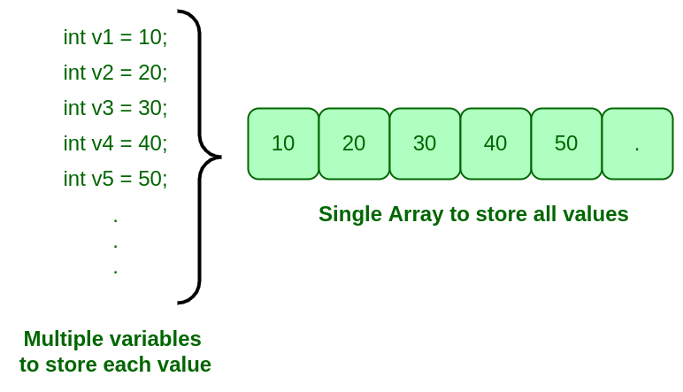

Slide 12
Array Declaration and Initialization in C
Syntax for array declaration in C : type arrayName [ arraySize ]
Method 1:
int arr[5]={1,2,3,4,5};
Method 2 :
int arr[ ]={1,2,3,4,5};
Method 3:
int arr[4];
arr[0]=1;
arr[1]=2;
arr[2]=3;
arr[3]=4;

Slide 13
Method 4 :
int arr[5];
int I ;
for( i = 0; i < 5 ; i ++ )
{
scanf(“%d”, &arr[ i ] );
}

Slide 14
Zero initialization :
int myArr[10] = {0};
Designated initialisation
int myArr[10]= {[0]=1, [5]=2 , [6]=3};

Slide 15
Challenge
Create a program that prints the following set of values in reverse order
34 , 54 , 60 , 75 , 86 , 90 , 120 , 140 , 155 , 200

